Slide 1
Fractions
EQ: What makes up a fraction and what are the different types of fraction?

Slide 2
Complete 5_Fractions introduction cloze worksheet

Slide 3
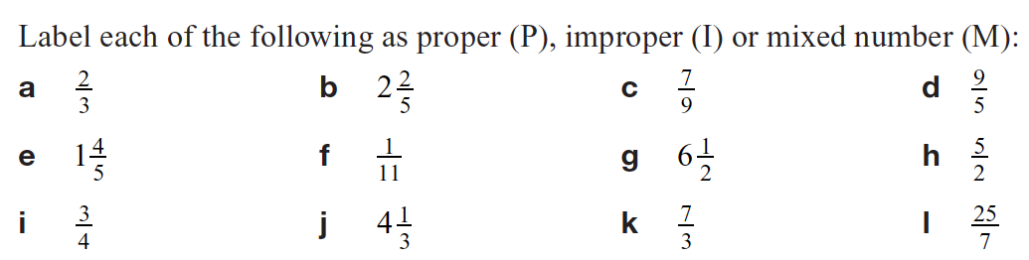
Using the terms “denominator”, “numerator” and “whole number” define:
A proper fraction
Improper fraction
Mixed number

Slide 4
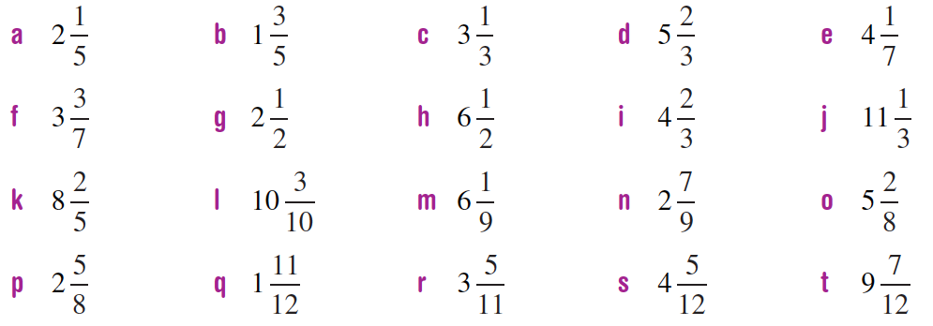
Convert these mixed numbers into improper fractions:

Slide 5
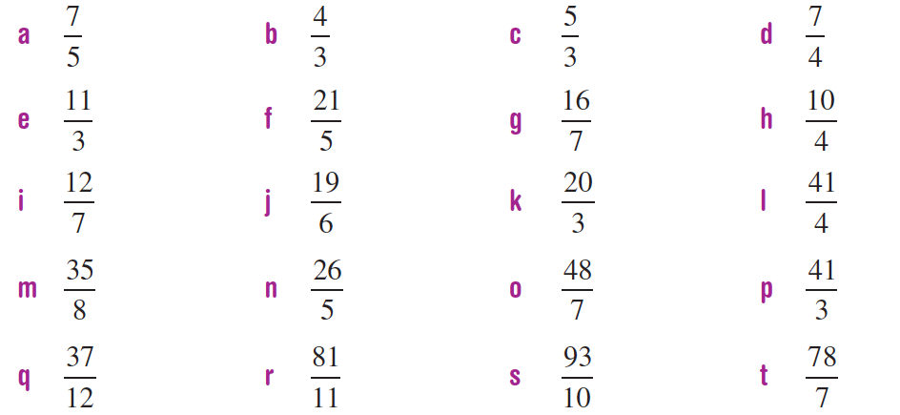
Convert these improper fractions into mixed numbers:

Slide 6
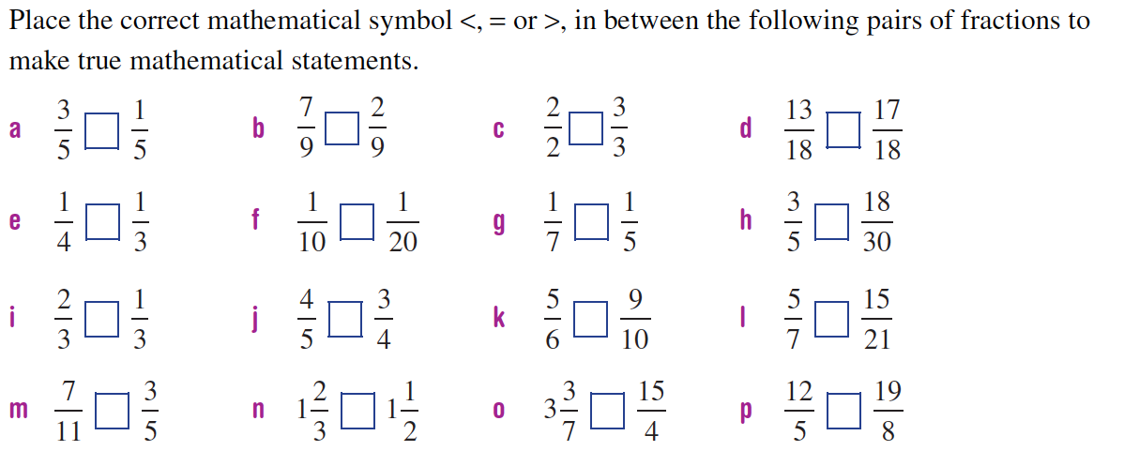

Slide 7
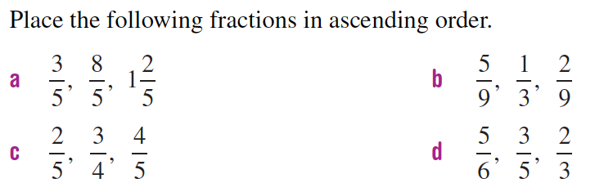

Slide 8
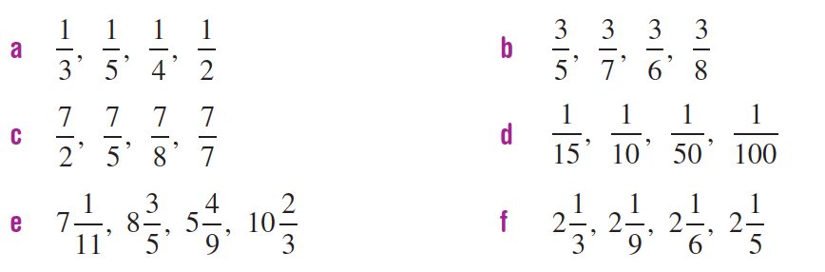
Write the following fractions in descending order:

